Slide 1
Quantum Simulation of the Water Molecule (H2O) via VQE
Optimization and Active Space Analysis on Hardware-Efficient Architectures
Simone Sticca

Slide 2
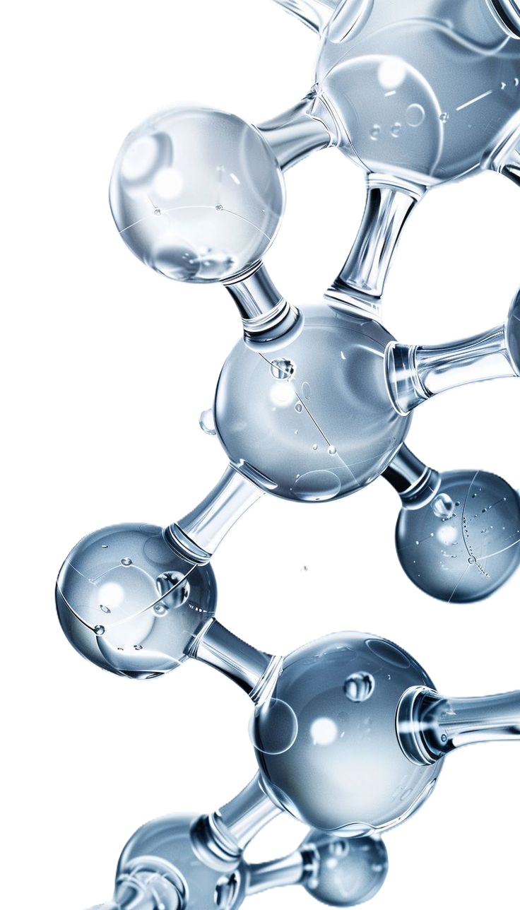
Project Objectives
Calculating the Ground State energy of the H2O molecule.
Implementing the Variational Quantum Eigensolver (VQE) using PennyLane.
Adapting the quantum circuit to meet physical hardware constraints.

Slide 3
Whats is vqe?
VQE (Variational Quantum Eigensolver) is a hybrid quantum-classical algorithm designed for NISQ computers.
Quantum Part (QPU): Evaluates the energy of a parameterized quantum state (the Ansatz).
Classical Part (CPU): Uses an optimizer to update the parameters and minimize the energy.
Theoretical basis: The Variational Principle (the measured energy is always ≥ the true Ground State energy).

Slide 4
The scalability challenge
(active space)
Standard mapping (STO-3G): 7 orbitals = 14 qubits (complexity 2^14).
Applied technique: Active Space Selection to reduce computational overhead.
Final configuration: 2 active electrons in 3 active orbitals = 6 qubits."

Slide 5
Pennylane
Open-source library developed by Xanadu, specifically designed for Quantum Machine Learning (QML).
Differentiable Quantum Computing: Treats quantum circuits as differentiable computational nodes (QNodes).
ML Integration: Native compatibility with NumPy, PyTorch, and TensorFlow for automatic gradient computation.
Hardware-Agnostic: Write code once and deploy it across multiple physical backends (e.g., IBM Qiskit, IQM, IonQ).

Slide 6
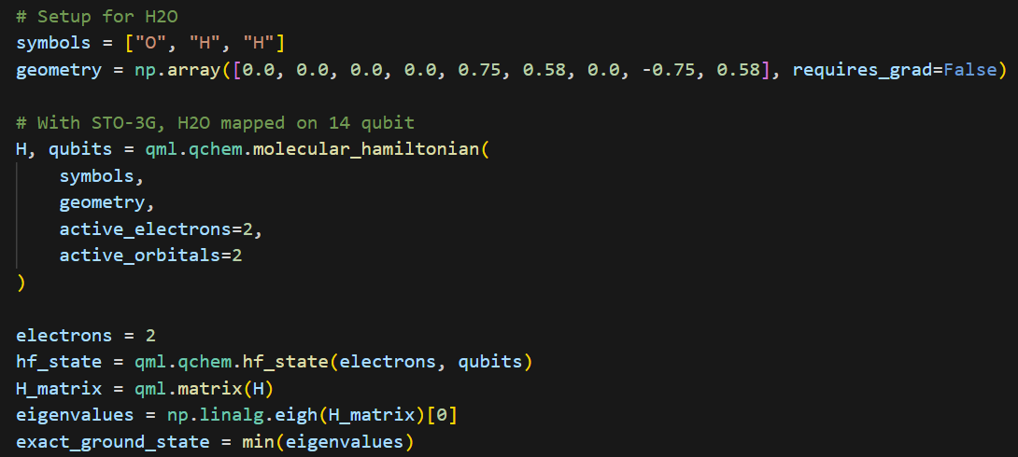
Hamiltonian preparation

Slide 7
Choosing the ansatz
Initialization: Hartree-Fock reference state.
Initial approach: Chemical ansatz (Excitations) — hardware-heavy and difficult to scale.
Final choice: Hardware-Efficient Ansatz (RY + CZ).
Advantage: Natively supported by quantum hardware, minimizing circuit depth and decoherence.

Slide 8
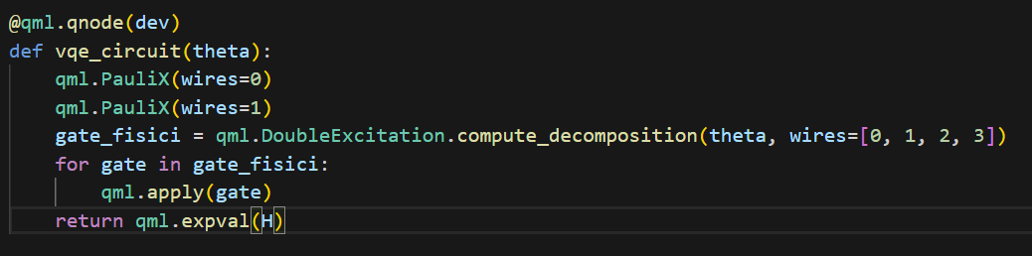
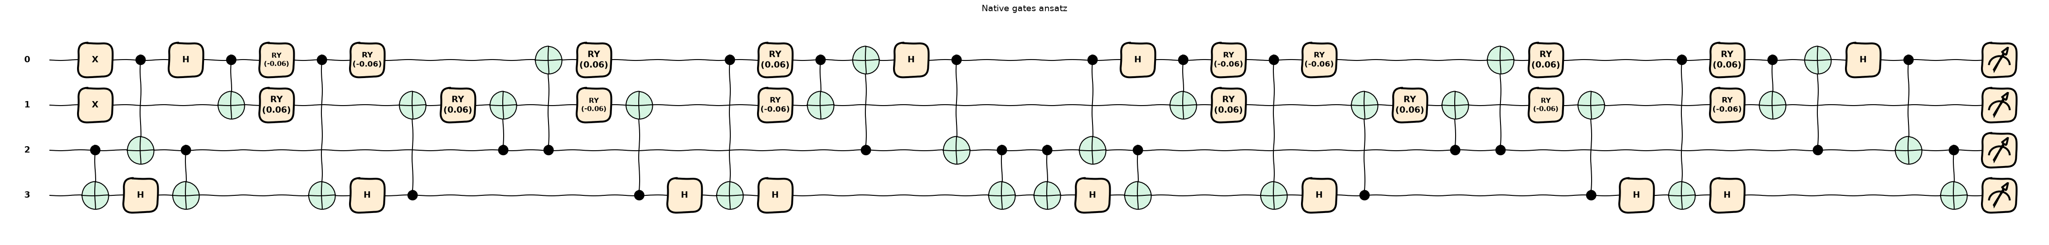
Double excitation (chemical ansatz)

Slide 9
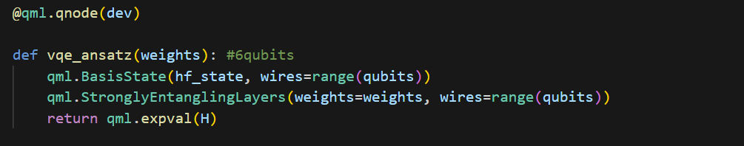
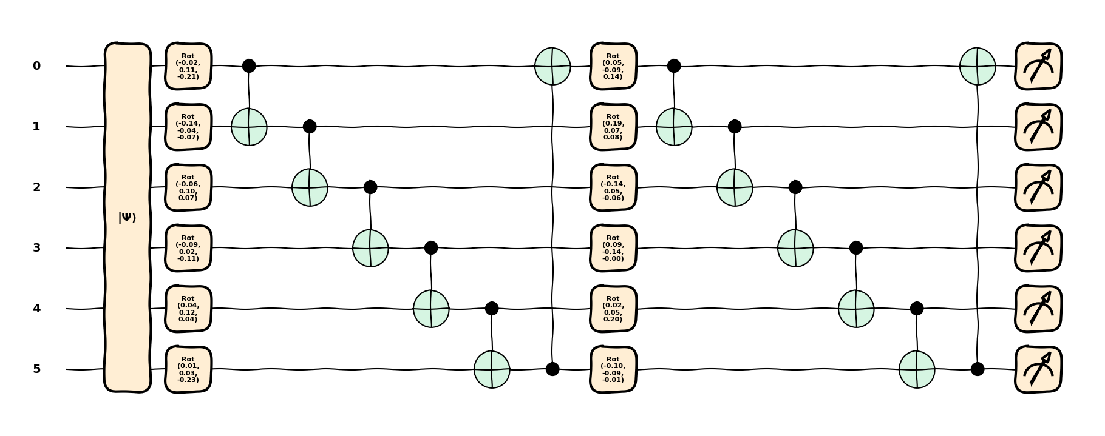
Strongly entangling layer
(6 qubits-hardware efficient)

Slide 10
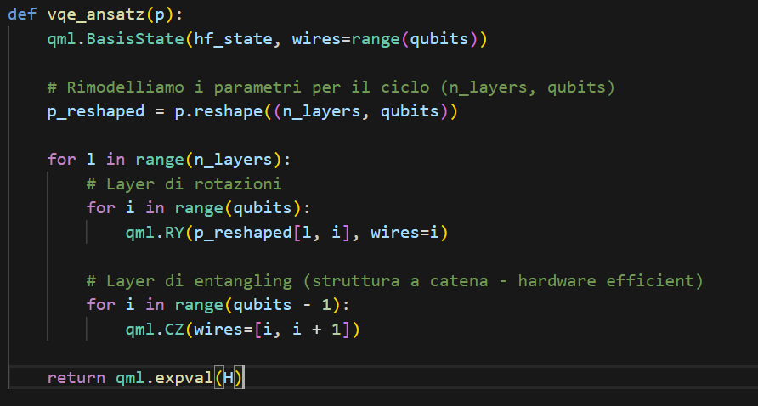
RY-cz
(6 qubits)

Slide 11
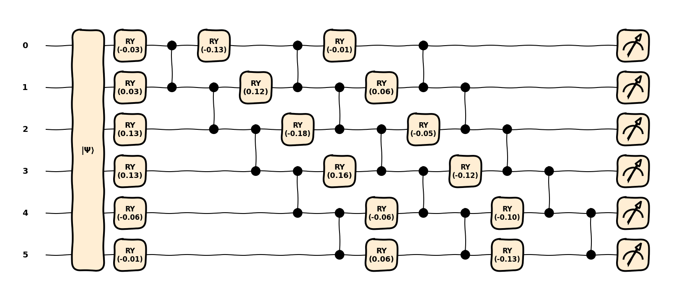

Slide 12
Optimization: adam vs gradient descent
Performance comparison in energy minimization.​
Gradient Descent: Highly sensitive to learning rate selection (prone to oscillations).
Adam Optimizer: Adaptive moment estimation provides significantly greater stability.

Slide 13
Result and analysis

Slide 14
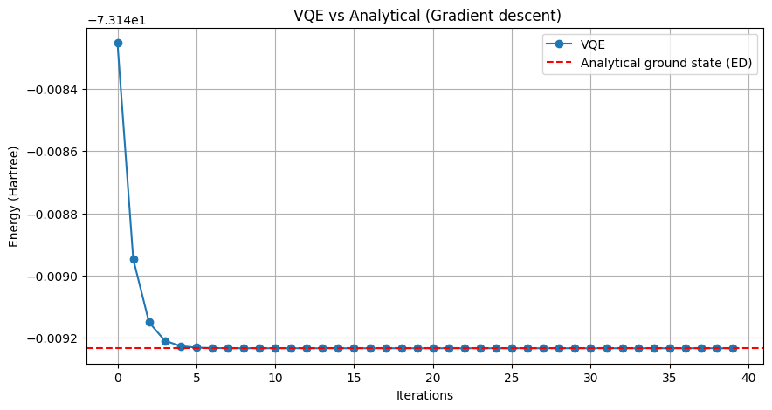
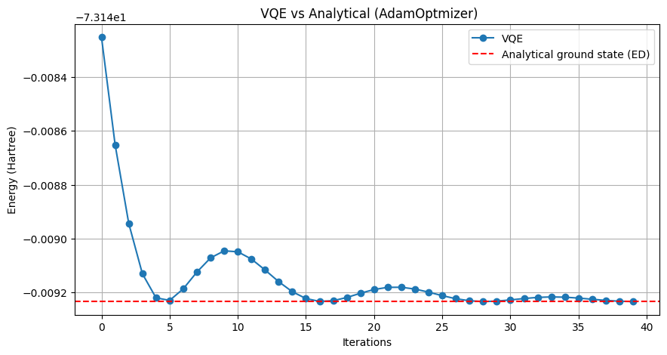
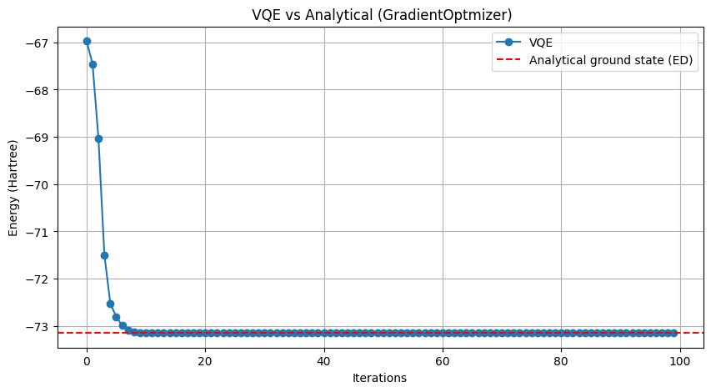
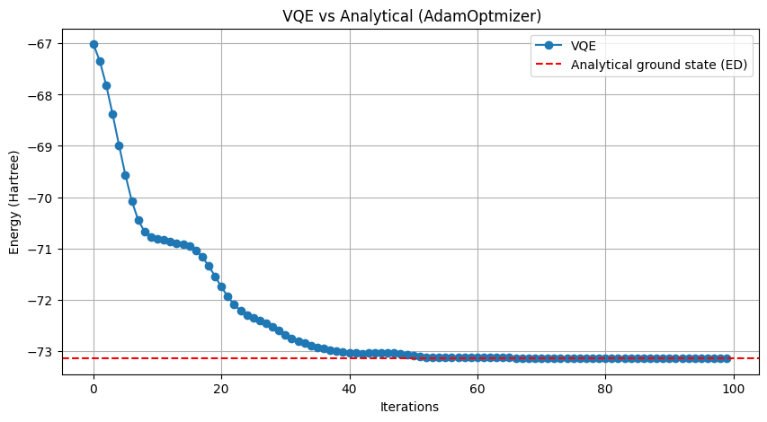
Active space: 2 orbitals (4 qubits, double excitation)
Active space: 3 orbitals (6 qubits, hardware efficient)
VQE final energy: -73.14825213 Hartree
Error: 0.00109570 Hartree
VQE final energy: -73.14560908 Hartree
Error: 0.00373876 Hartree

Slide 15
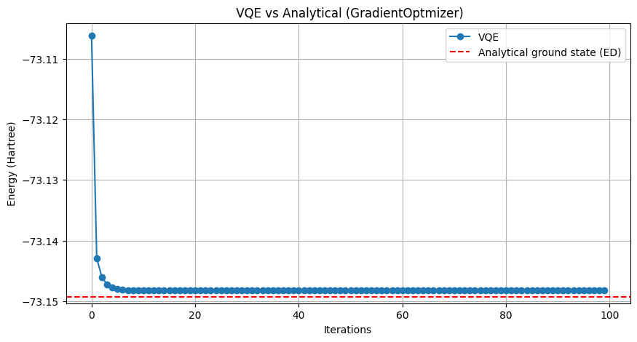
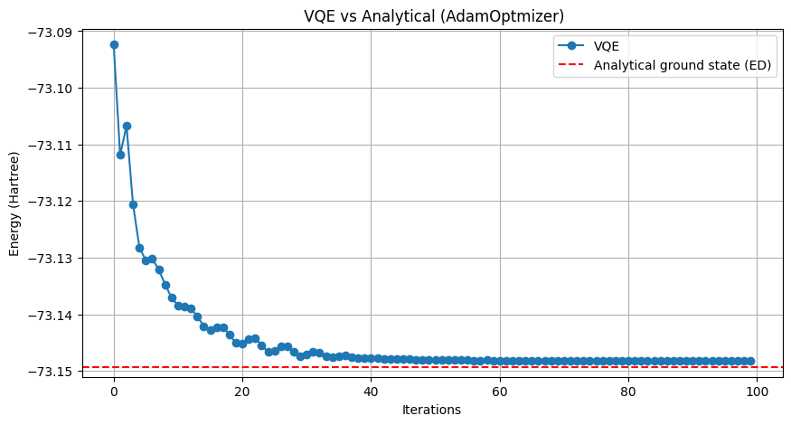
Active space: 3 orbitals (6 qubits)
RY-CZ
Exact energy (analytical ground state):
-73.14934783 Hartree
Exact energy (analytical ground state):
-73.14934783 Hartree
VQE final energy: -73.14822599 Hartree
Error: 0.00112185 Hartree
VQE final energy: -73.14824989 Hartree
Error: 0.00109794 Hartree

Slide 16
Thank you
Simone Sticca

